Slide 1

PROJECTION OF EMPLOYEE WAGES BASED ON SKILL & COMPETENCE
G.SHIRISHA – 19071D5804
GUIDE -Dr. M. RAJA SEKAR
(Professor)

Slide 2
ABSTRACT
Identifying most rewarded and demanded items in job offers is key for recruiters and candidates. It’s well-known in HR that recruiting new employees is substantially more expensive than retaining existing talent. Employees who depart take with them valuable experience and knowledge from your organisation. Strategic planning and talent management in large enterprises composed of knowledge workers requires complete, accurate, and up-to-date representation of the expertise of employees in a form that integrates with business processes. In this work, we deploy an analytics-driven solution that infers the expertise of employees through the mining of enterprise and social data that is not specifically generated and collected for expertise inference. We consider job role and specialty prediction and pose them as supervised classification problems.

Slide 3
Purpose
Performance appraisal process provides a means for discussing, planning and reviewing the performance of each employee.
Performance appraisals influence salaries, promotions and transfers
Assigns overall performance ratings.
Does not always result in an automatic salary increase.
Employee's overall performance and salary level to position responsibilities must be evaluated to determine whether a salary increase is warranted.
Focus not only on salary but also churn prediction of an employee

Slide 4
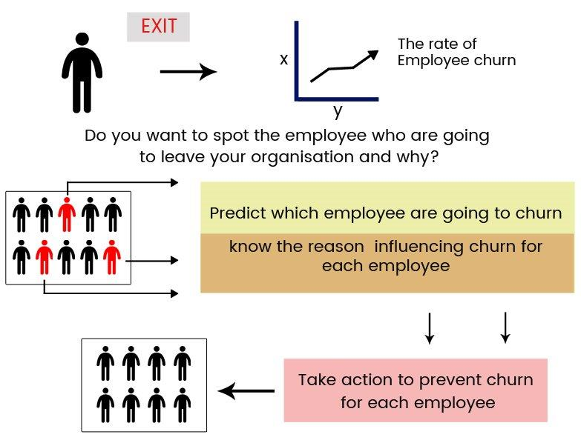

Slide 5


Slide 6
01 | Prediction of Job Applicant Salary and Designation | Ashok Kumar S, Santhosh V, Saranyadevi S | April 6,2020 | 6
Findings:
This system is fully supported by recruiting a candidate for a job based on their performance within the interview and their test scores are analysed to predict their basic salary once a year.
It does not provide proper coordination between the different candidates of the company.
The experimental results show that k-means clustering the algorithm features an outstanding result on dataset.

Slide 7
02 | Salary Prediction in IT Tech Job Market | Navyashree M, Neetu M, Pooja G R | May 15,2019 | 15
Findings:
Random Forest Regression machine learning rule is applied to predict salary levels of individuals.
Accuracy of the Random forest on test data is 97%, while the accuracy of Decision tree and SVM is 85% and 90% respectively
Problem:
To choose effective machine learning rule so as to unravel the problems of classification and prediction of data is the most vital part of machine learning which depends on dataset.

Slide 8
03 | Job Portal Analysis and Salary Prediction System | Robyn Stone, Jess Wilhelm, Christine E. Bishop | March 3,2020 | 7
Findings:
An effective job portal analysis and salary prediction system for fresher or professional could choose the right platform to build a career in by knowing exactly which skills are trending in the IT Market.
Problem:
Problem of predicting salary for job advertisements in which salary are not mentioned and also tried to help fresher to predict possible salary for different companies in different locations

Slide 9
04 | Salary Prediction Using Regression Techniques | Sayan Das Ayush Mukherjee | Jan 14,2020 | 2
Findings:
Graphical representation of predicting salary is a process that aims for developing computerized system to maintain all the daily work of salary growth graph in any field and can predict salary after a certain time period.
Choosing the salary from x-y graph as it is to use to represent a specific data set that takes some trial and error.
This prediction is correct up to a certain percentage. More accuracy can be obtained by implementing k-nearest regression

Slide 10
05 | Salary Prediction using CNN | Zhongsheng Wang Shinsuke Sugaya | April 3,2019 | 5
Findings:
Main concerns in these works are to test types of algorithms, and then ensemble different results, rather than to train single elective model which can be of practical use in real service.
Using NLP it explores more possibility on text regression with combination model is an important direction in both research and application development. We use Mean Absolute Error(MAE) as evaluation standard in our experiments

Slide 11
06 | Modelling and Predicting Individual Salaries | Tapio Nummi Janne Salonen | May 16,2020 | 3
Findings:
Clearly individual wage profiles are needed in pension system development but the modelling is often limited by lack of adequate data.
We have focused on the problem of modelling and predicting future salaries of individuals given past salaries
Problem:
The problem of salary projections is very old in pension insurance and different types of models have been proposed in the literature for describing average salary profiles. Describes low , middle waged quarters and high wages

Slide 12
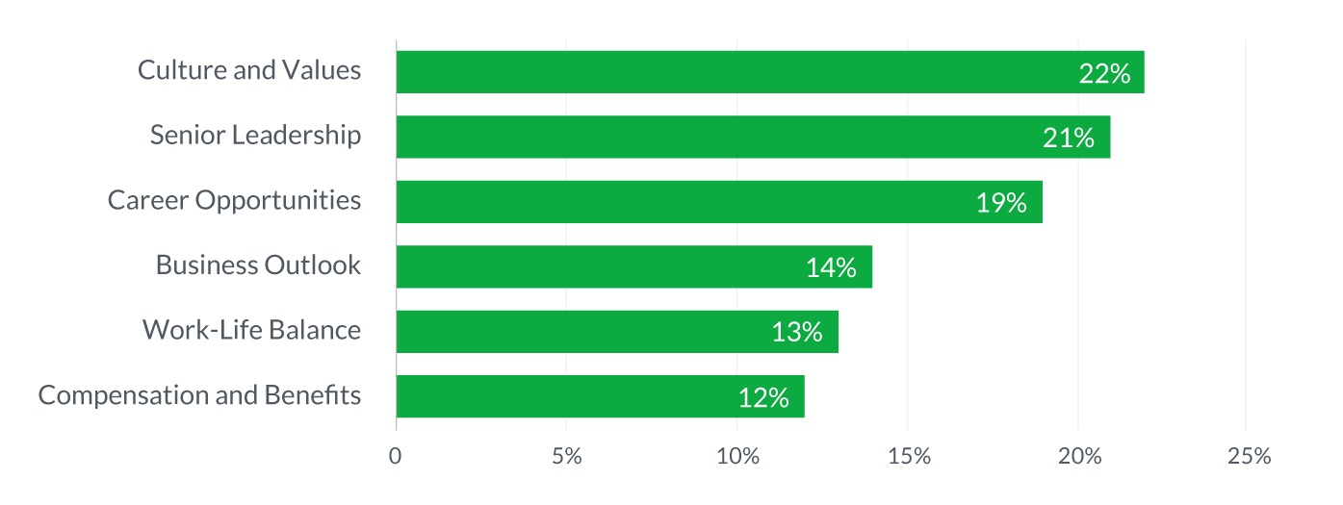
Terms used to predict
Plays an important role to be part of company. These factors helps to project the need of salary based on skill and competences.

Slide 13
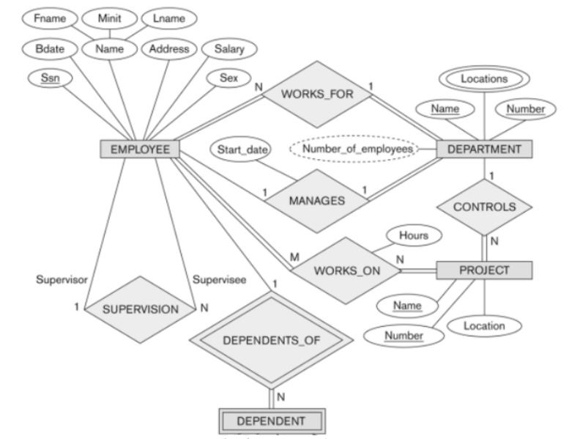
ER DIAGRAM

Slide 14
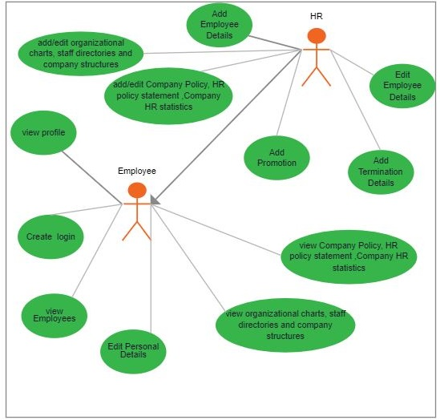
USE CASE DIAGRAM

Slide 15
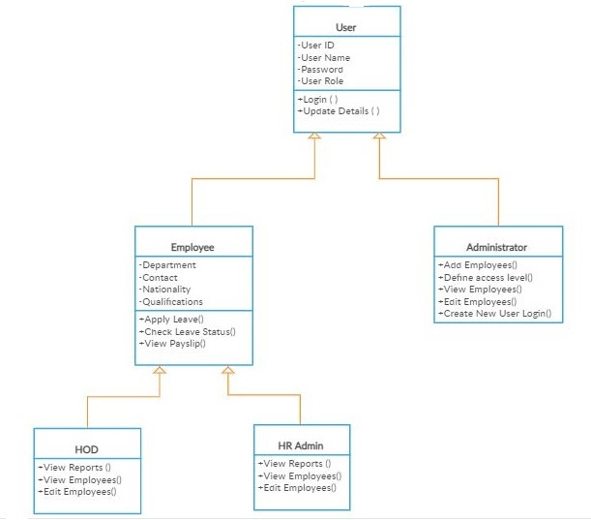
CLASS DIAGRAM

Slide 16
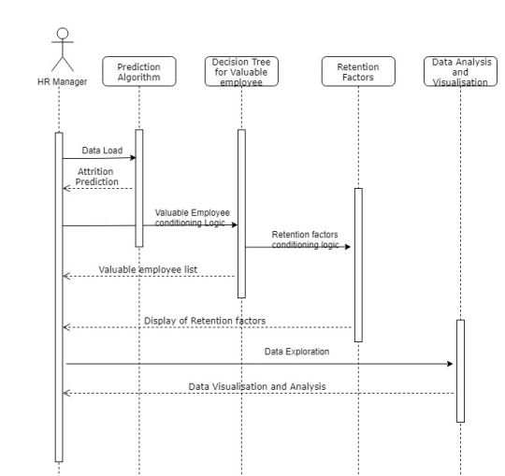
SEQUENCE DIAGRAM

Slide 17
Conclusion
It is evident that industries cannot survive in the long run if they do not possess predictive analytics skills from the human resource management. Employee attrition is one of the biggest challenges organizations face currently. The cost of the loss of an employee and replacing them with another one can turn the focus away from the organization’s bottom line. Instead, analytics can be used to prevent this in the first place by identifying at-risk employees. By analysing factors such as pay, promotions, company environment, and relationships with managers, predictive analytics can reveal who may be the most likely to leave the organization, serving as a game changer in the personalization of the engagement process for those employees and their retention.

Slide 18


